Slide 1
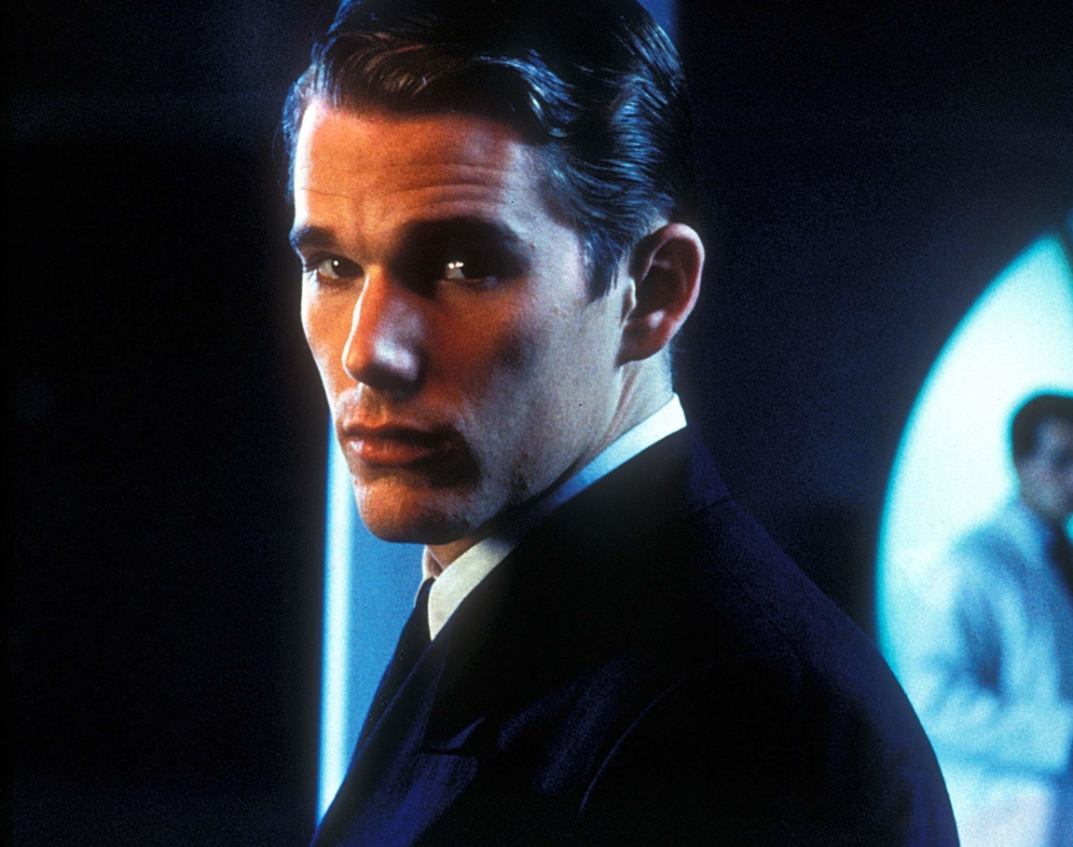

Gattaca
Brandon Thompson

Slide 2
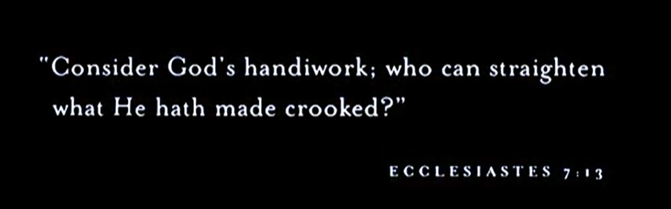
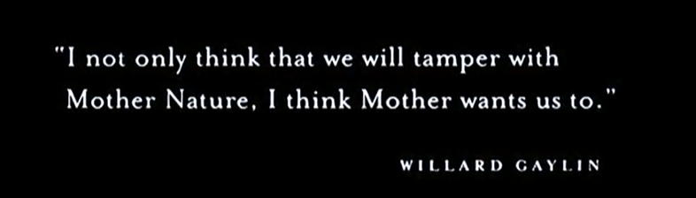
Opening scenes
This quote from the Bible signifies that nobody can improve on what God has created, which is exactly what the movie tries to do.
If Mother Nature didn’t want us to make changes “she” would not have made it possible.
Notes:
The movie uses these two quotes in the beginning to set up the plot for gene editing. Before we could not fix the issues, mother nature wants us to experiment.

Slide 3
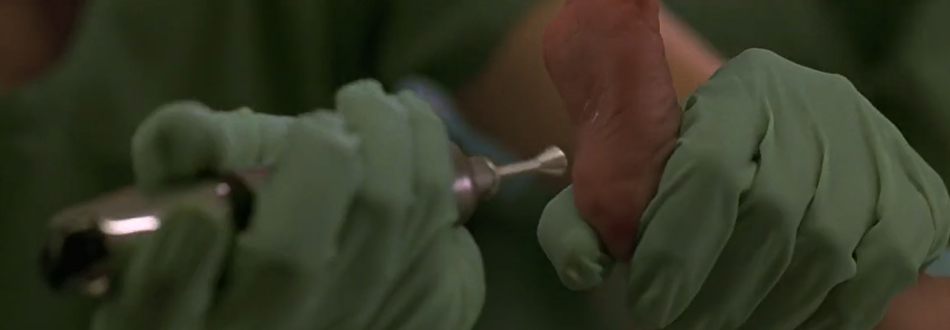
Technology
“Now, only seconds old the exact time and cause of my death was already known.” – Vincent
Notes:
We first see the technology presented in Gattaca when Vincent is born. Vincent was born how we would call normal. Unfortunately for him, the normal at the time was to be heavily genetically modified. This scene shows a nurse taking blood from his foot, using this they are able to read his DNA. The nurse lists off probabilities of neurological conditions, mental illnesses, heart problems and life expectancy.

Slide 4
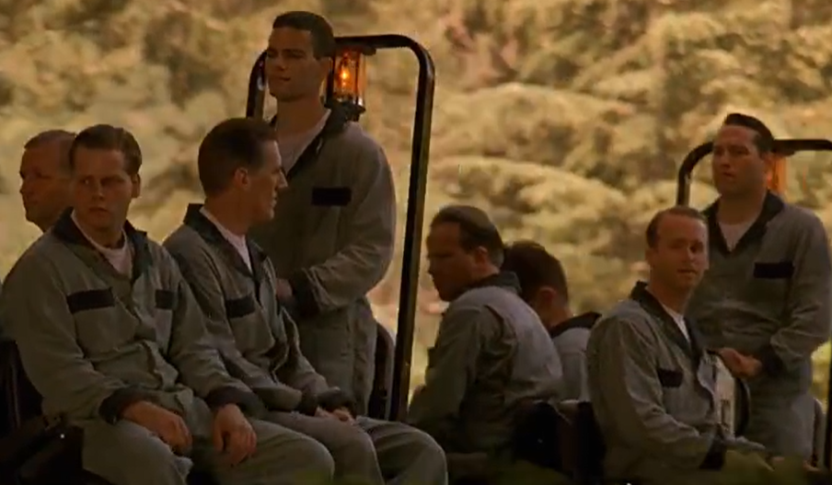
Discrimination / Genoism
“I belonged to a new underclass, no longer determined by social status or the color of your skin. Now we now have discrimination down to a science.”
– Vincent
“It didn’t matter how much I lied on my resume; my real resume was in my cells.”
– Vincent
Notes:
What results from this technology is the discrimination against those who are not genetically enhanced or “Genoism.” [Read quotes] People that were not enhanced were basically only allowed to clean. Genosim is against the law but if you refuse to give a sample, they will take skin cells from a door handle or require a mandatory drug test and use this as an illegal sample. A position on a spaceship is highly coveted, and, even in real life, people with heart problems are not allowed.

Slide 5
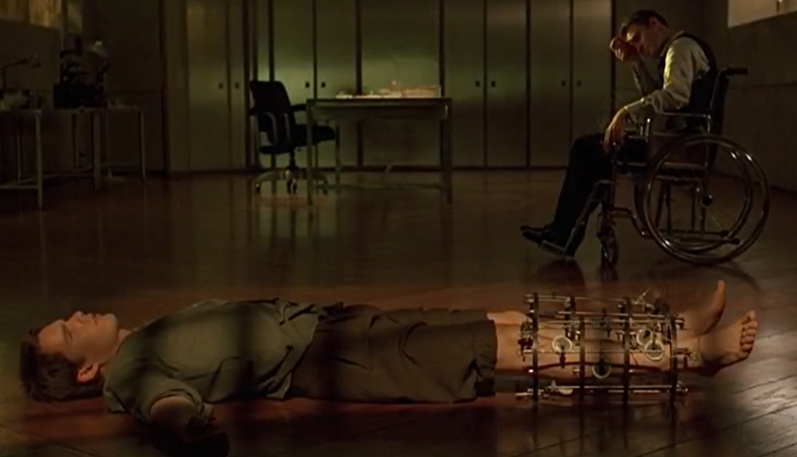
Vincent’s Solution
“When, for one reason or another, a member of the elite falls on hard times, their genetic identity becomes a valued commodity for the unscrupulous.”
– Vincent
Notes:
Vincent’s solution (and many others) is to take the identity of Jerome, a former professional swimmer, and use his credentials to apply to Gattaca. Vincent undergoes surgery to look more like Jerome and Jerome has to provide urine, blood, skin and hair samples daily so that Vincent can get inside and pass drug tests.

Slide 6
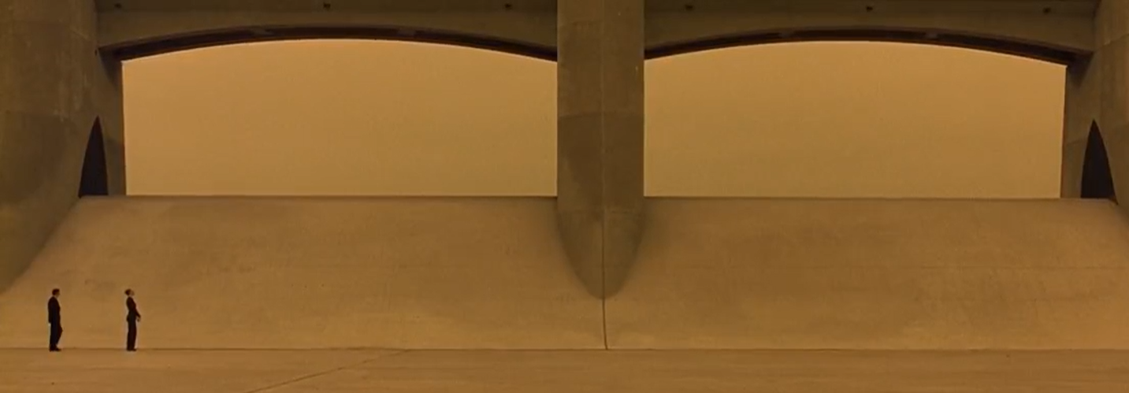
Dystopian Themes
Notes:
From the beginning, the film is showcased as dystopian, everyone is labeled as a ‘valid’, those that are enhanced, or an ‘in-valid’ those that are not. Invalids are segregated, not allowed good jobs and have lower life expectancies. While to focus is on Invalids, the genetically enhanced also suffer from the burden of perfection, it is harder to deal with failure when you are made to be perfect, how do you compete when everyone is the best? Some more subtle themes are the fact that everyone at Gattaca dresses the same, black suits and ties and the police all have grey trench coats and hats. As well as buildings being large, ominous and bland and the fact that you never see the sun.

Slide 7
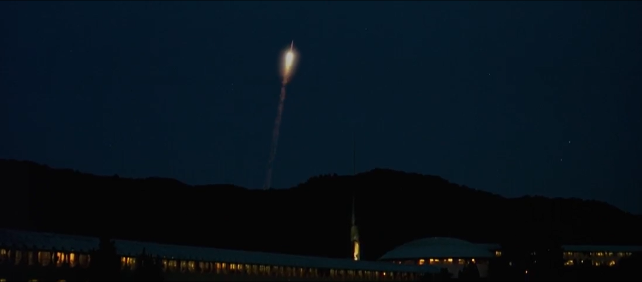
Relevance
Notes:
Gattaca is a relevant work for this course because of how gene editing technology has affected the culture in Gattaca. Similar technologies are within reach with CRISPR/Cas9 gene editing tools that we reviewed earlier this year. While the effect was not as catastrophic as presented in Oryx and Crake, Gattaca feels more possible to happen.

Slide 8
Questions?

